Slide 1

Note: The data and information in this document is reflective of a hypothetical situation and client. This document is to be used for KPMG Virtual Internship purposes only.
Sprocket Central Pty Ltd
Data analytics approach
[Division Name] - [Engagement Manager], [Senior Consultant], [Junior Consultant]

Slide 2
Note: The data and information in this document is reflective of a hypothetical situation and client. This document is to be used for KPMG Virtual Internship purposes only.
Agenda
Introduction
Data Exploration
Model Development
Interpretation

Slide 3
Note: The data and information in this document is reflective of a hypothetical situation and client. This document is to be used for KPMG Virtual Internship purposes only.
Introduction
Data Quality Assessment
 | CUSTOMER DEMOGRAPHIC | CUSTOMER ADDRESS | TRANSACTION DATE
ACCURACY | DOB : Inaccuracy Job Industry category: Misspelling
COMPLETENESS | DOB: Blank Job Title: Blank Job Industry Category: Blank Customer ID: Not sync | Customer ID: Not sync | Standard Cost: Blank Brand: Blank Product Line : Blank Product size; Blank Product first sold date: Blank Customer Id : Bank
CONSISTENCY | Gender: Inconsistency | States; Inconsistency
CURRENCY | Deceased Customer: Filtered out
RELEVANCY | Default: Exclude field |  | Order status: Exclude Cancelled
VALIDITY |  |  | Product first sold date; format
.

Slide 4
Note: The data and information in this document is reflective of a hypothetical situation and client. This document is to be used for KPMG Virtual Internship purposes only.
Introduction
Data Cleaning
Records with missing fields dropped
Join keys between tables were considered and conflicting records were dropped.
Age, Last Purchase (Days Ago) and Profit fields were added.
Records pertaining to deceased customers were dropped
Transactions more than a year dropped
Distinct Customer ID received : 4000
Distinct customer ID after data cleaning: 3492
.

Slide 5
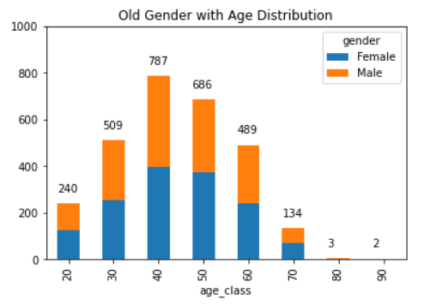
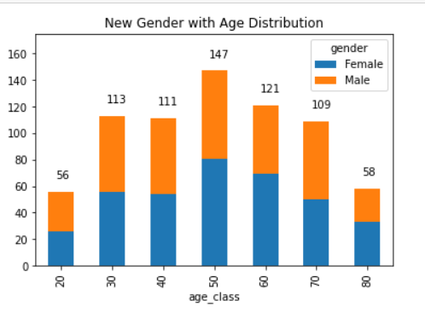
Note: The data and information in this document is reflective of a hypothetical situation and client. This document is to be used for KPMG Virtual Internship purposes only.
Data Exploration
Gender with Age distribution

Slide 6
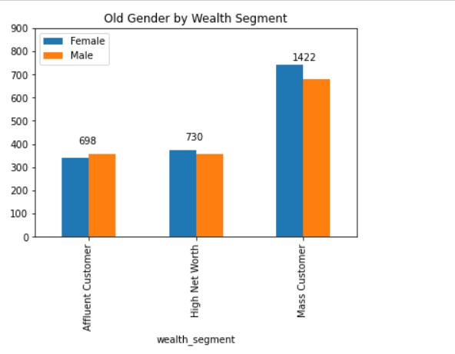
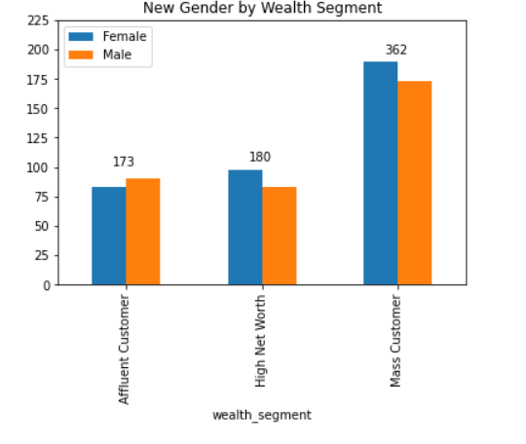
Note: The data and information in this document is reflective of a hypothetical situation and client. This document is to be used for KPMG Virtual Internship purposes only.
Data Exploration
Gender with Wealth Segment

Slide 7
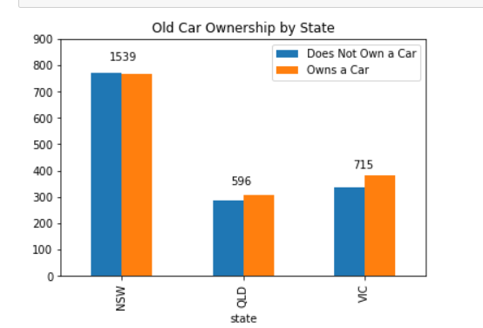
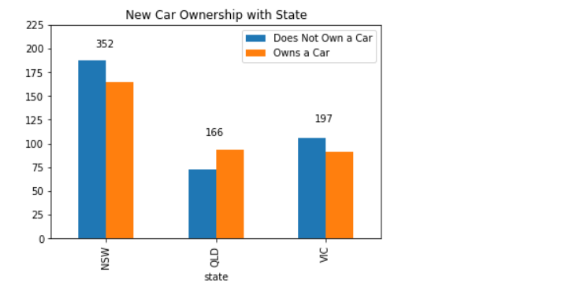
Note: The data and information in this document is reflective of a hypothetical situation and client. This document is to be used for KPMG Virtual Internship purposes only.
Data Exploration
Car Ownership with State

Slide 8
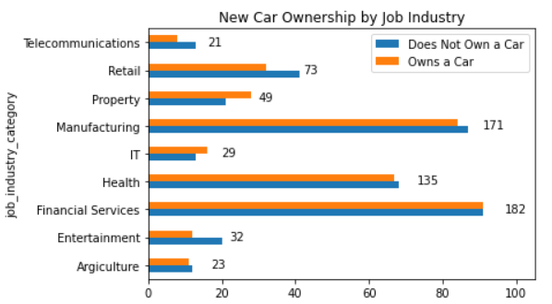
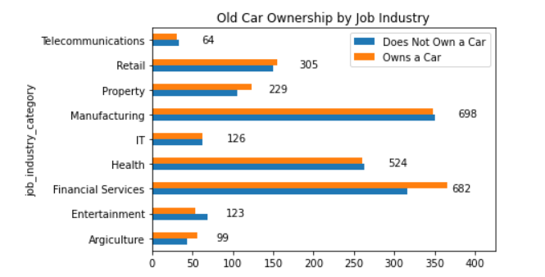
Note: The data and information in this document is reflective of a hypothetical situation and client. This document is to be used for KPMG Virtual Internship purposes only.
Data Exploration
Car Ownership with Job Industry

Slide 9
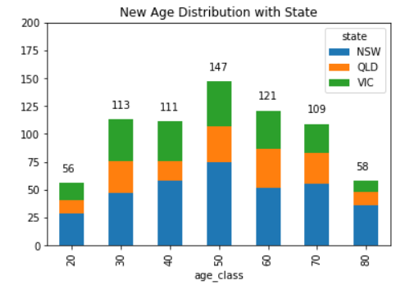
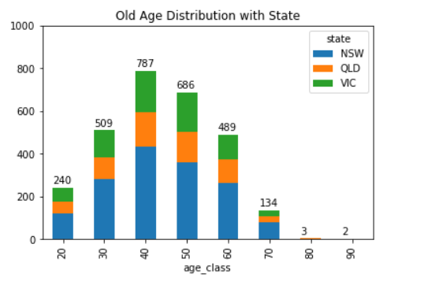
Note: The data and information in this document is reflective of a hypothetical situation and client. This document is to be used for KPMG Virtual Internship purposes only.
Data Exploration
Age Distribution with State

Slide 10
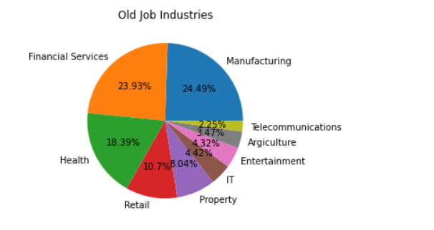
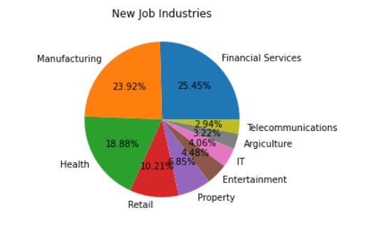
Note: The data and information in this document is reflective of a hypothetical situation and client. This document is to be used for KPMG Virtual Internship purposes only.
Data Exploration
Job Industry Diversity
.

Slide 11
Note: The data and information in this document is reflective of a hypothetical situation and client. This document is to be used for KPMG Virtual Internship purposes only.
Model Development
RFM Analysis
RECENCY
The last day on which customer performed a transaction was taken as recency parameter
Customers are divided into 4 quartiles and given a R score
FREQUENCY
The frequency of transactions done by particular customer was taken as the frequency parameter
Customers are divided into 4 quartiles and a given a F score
MONETARY VALUE
The average profit per customer was taken as the monetary value parameter
Customers were divided into 4 quartiles and given a M score

Slide 12
Note: The data and information in this document is reflective of a hypothetical situation and client. This document is to be used for KPMG Virtual Internship purposes only.
Model Development
RFM Analysis
Based on RFM Class, four customers are identified:
Gold: These customers have recently made a purchase, are frequent and are most profitable
Silver
Bronze
Basic: These customers have not made any recent purchase, are not frequent and do not contribute majorly

Slide 13
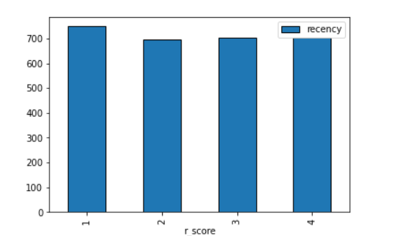
Note: The data and information in this document is reflective of a hypothetical situation and client. This document is to be used for KPMG Virtual Internship purposes only.
Model Development
RFM Analysis

Slide 14
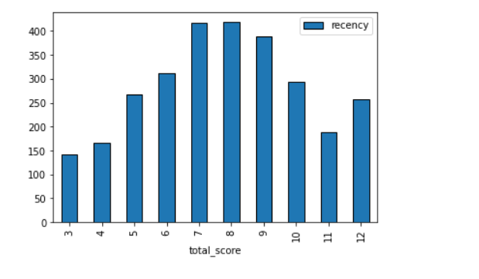
Note: The data and information in this document is reflective of a hypothetical situation and client. This document is to be used for KPMG Virtual Internship purposes only.
Model Development
RFM Analysis

Slide 15
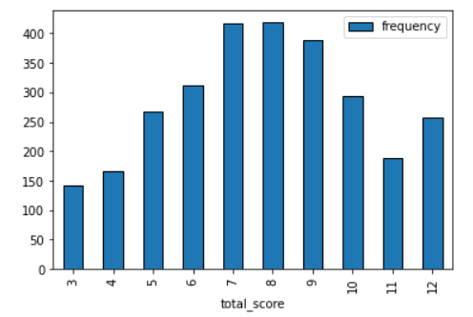
Note: The data and information in this document is reflective of a hypothetical situation and client. This document is to be used for KPMG Virtual Internship purposes only.
Model Development
RFM Analysis

Slide 16
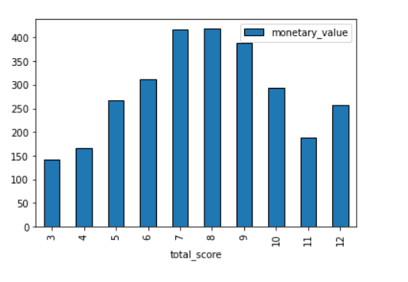
Note: The data and information in this document is reflective of a hypothetical situation and client. This document is to be used for KPMG Virtual Internship purposes only.
Model Development
RFM Analysis

Slide 17
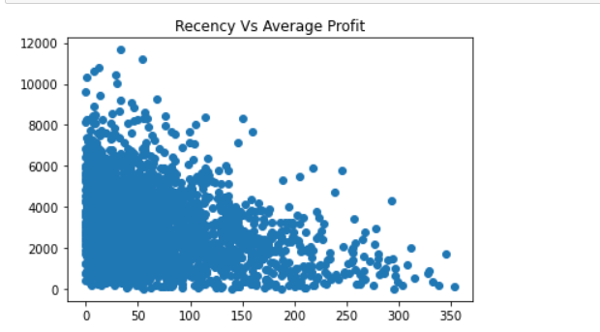
Note: The data and information in this document is reflective of a hypothetical situation and client. This document is to be used for KPMG Virtual Internship purposes only.
Model Development
RFM Analysis

Slide 18
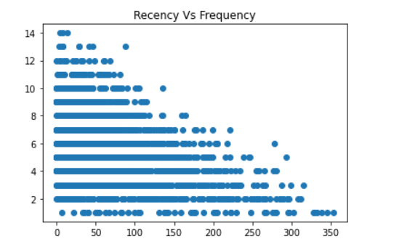
Note: The data and information in this document is reflective of a hypothetical situation and client. This document is to be used for KPMG Virtual Internship purposes only.
Model Development
RFM Analysis

Slide 19
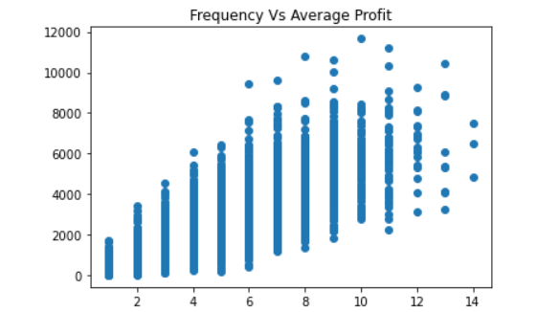
Note: The data and information in this document is reflective of a hypothetical situation and client. This document is to be used for KPMG Virtual Internship purposes only.
Model Development
RFM Analysis

Slide 20
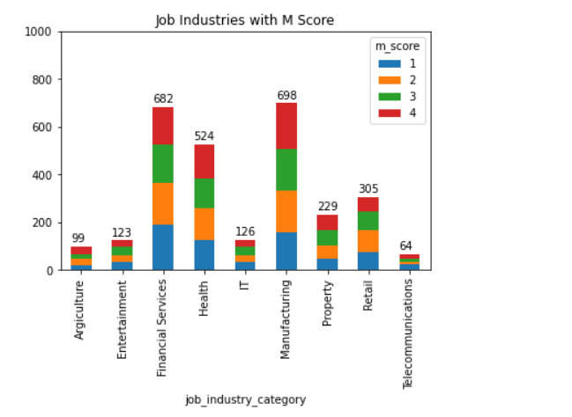
Note: The data and information in this document is reflective of a hypothetical situation and client. This document is to be used for KPMG Virtual Internship purposes only.
Interpretation
Profitable Job Industries

Slide 21
Note: The data and information in this document is reflective of a hypothetical situation and client. This document is to be used for KPMG Virtual Internship purposes only.
Interpretation
Customer Segments
SEGMENT | RFM SCORE | CUMULATIVE
Platinum | 3 | 134
Very Loyal | 4 | 296
Becoming Loyal | 5 | 558
Recent | 6 | 891
Average | 7 | 1300
High Risk | 8 | 1712
Evasive | 9 | 2110
Losing | 10 | 2417
Inactive | 11 | 2595
Lost | 12 | 2850

Slide 22
Note: The data and information in this document is reflective of a hypothetical situation and client. This document is to be used for KPMG Virtual Internship purposes only.
Interpretation
Targeting Methodology
Customers having high RFM scores can be filtered and targeted
The customers have made recent purchases are frequent and drive the most profits

Slide 23
Note: The data and information in this document is reflective of a hypothetical situation and client. This document is to be used for KPMG Virtual Internship purposes only.
Appendix

Slide 24
Note: The data and information in this document is reflective of a hypothetical situation and client. This document is to be used for KPMG Virtual Internship purposes only.
Appendix
This is an optional slide where you may place any supporting items.

Slide 25
SUBMITTED BY
Surmeet Mohanty

